Slide 1
Chapter 5 Space Complexity
General preliminaries and issues
Log space classes: L, NL
Savitch’s Theorem
NSPACE(s)⊆DSPACE(s^2)
Immerman’s Theorem： NL=co-NL
PSPACE and QBF

Slide 2
Savitch’s Theorem
Theorem:
NSPACE(logn) ⊆DSPACE(log²n)
Proof:
First prove CONN is NL-complete (under log-space reductions)
Then show an algorithm for CONN that uses log²n space

Slide 3
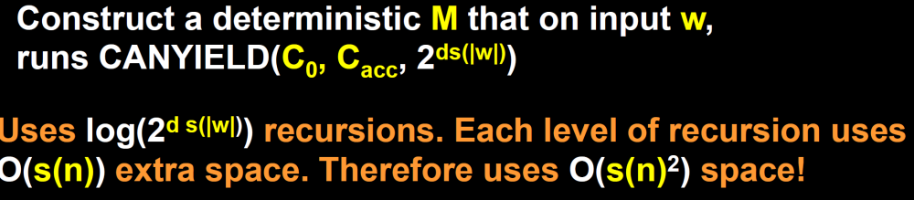
Savitch: Generalized Version
Theorem (Savitch):
∀S(n) ≥ log(n)
NSPACE(S(n)) ⊆ SPACE(S(n)²)
Proof: We proved NL⊆SPACE(log²n). The theorem follows from the padding argument. 

Slide 4
Corollary
Corollary: PSPACE = NPSPACE
PSPACE is the class of problems that are decidable in polynomial space on a det. TM.
PSPACE= U_k SPACE(n^{k}).
Proof:
Clearly, PSPACE⊆NPSPACE.
By Savitch’s theorem, NPSPACE⊆PSPACE. 

Slide 5
Space Vs. Time
We’ve seen space complexity probably doesn’t resemble time complexity:
  Non-determinism doesn’t decrease the space complexity drastically (Savitch’s theorem).
We’ll next see another difference:
  Non-deterministic space complexity classes are closed under completion (Immerman’s theorem).

Slide 6
NON-CONN
NON-CONN
Instance: A directed graph G and two vertices s,t∈V.
Problem: To decide if there is no path from s to t.

Slide 7
NON-CONN
Clearly, NON-CONN is coNL-Complete.
(Because CONN is NL-Complete)
If we’ll show it is also in NL, then NL=coNL.

Slide 8
An Algorithm for NON-CONN
Count how many vertices are reachable from s.
Take out t and count again.
Accept if the two numbers are the same.

Slide 9
Efficiency
Lemma: The algorithm uses O(log(n)) space.
Proof:
There is a constant number of variables ( d, count, u, v, count_{d-1}). Each requires O(log(n)) space (range |V|). 

Slide 10
Immerman’s Theorem
Theorem[Immerman/Szelepcsenyi]: NL=coNL
Proof:
(1) NON-CONN is NL-Complete
(2) NON-CONN∈NL
Hence, NL=coNL. 

Slide 11
Thm: NL = co-NL.
Robert Szelepcs’enyi, “The method of forcing for nondeterminitic automata,” Bull of the EATCS, 33, p.96-100, 1987.
N. Immerman, “Nondeterministic space is closed under complementation,“ SIAM J. on computing 17, p.935-938, 1988 .
Gödel Prize 1995

Slide 12
Corollary
Corollary:
∀s(n)≥log(n), NSPACE(s(n))=coNSPACE(s(n))

Slide 13


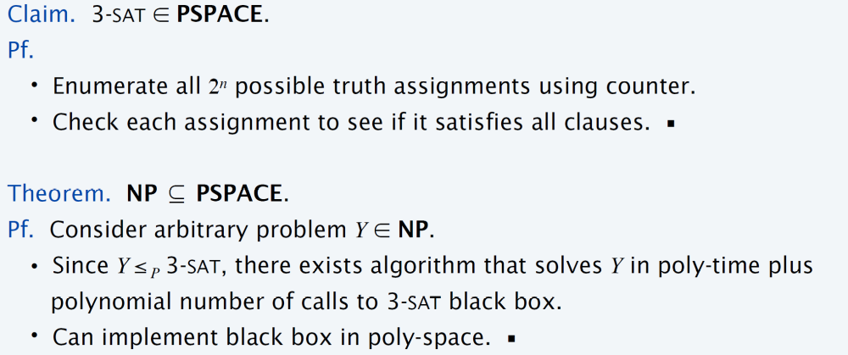
P, NP, PSPACE

Slide 14
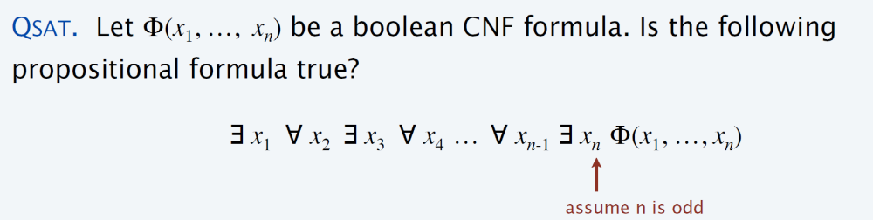
TQBF
We can use the insight of Savich’s proof to show a language which is complete for PSPACE.
We present TQBF, which is the quantified version of SAT.

Slide 15
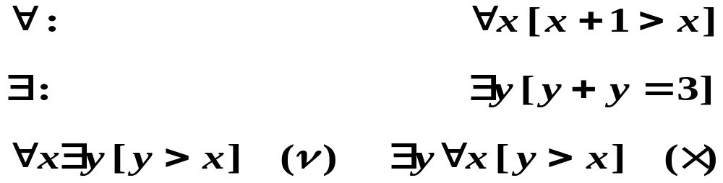

universal quantifier,
existential quantifier,
φ =
~quantified Boolean formula
~fully quantified Boolean formula

Slide 16
TQBF
Instance: a fully quantified Boolean formula φ
Problem: to decide if φ is true
Example: a fully quantified Boolean formula
∀x∃y∀z[(x∨¬y∨z)∧(¬x∨y)]
Variables` range is {0,1}

Slide 17
TQBF is in PSPACE
Theorem: TQBF∈PSPACE
Proof: We’ll describe a poly-space algorithm A for evaluating φ:
If φ has no quantifiers: evaluate it
If φ=∀x(ψ(x)) call A on ψ(0) and on ψ(1); Accept if both are true.
If φ=∃x(ψ(x)) call A on ψ(0) and on ψ(1); Accept if either is true.

Slide 18
Algorithm for TQBF
1
∀x∃y[(x∨¬y)∧(¬x∨y)]
1
1
∃y[(0∨¬y)∧(¬0∨y)]
∃y[(1∨¬y)∧(¬1∨y)]
(0∨¬0)∧(¬0∨0)
(0∨¬1)∧(¬0∨1)
(1∨¬0)∧(¬1∨0)
(1∨¬1)∧(¬1∨1)
1
0
0
1

Slide 19
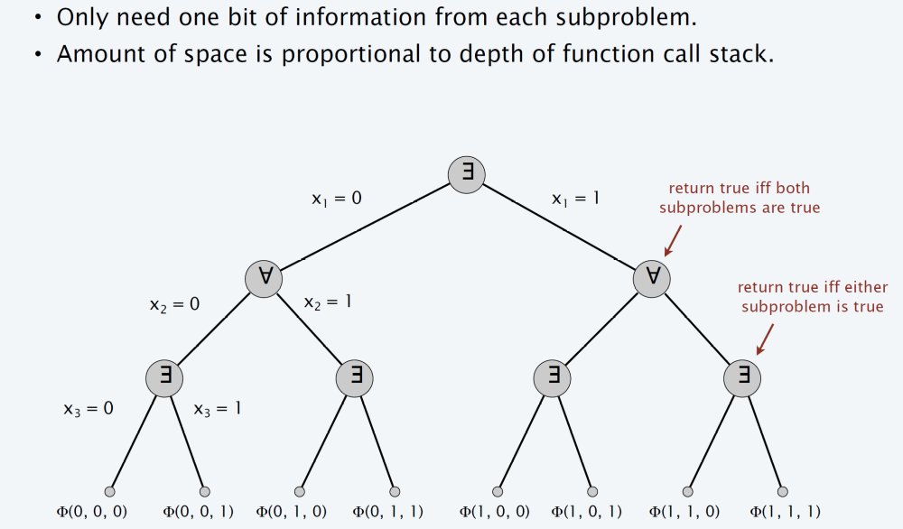

Slide 20
Efficiency
Since both recursive calls use the same space,
the total space needed is polynomial in the number of variables (the depth of the recursion)
⇒ TQBF is polynomial-space decidable 

Slide 21
PSAPCE Completeness
Definition:
B is PSPACE-Complete if
B∈PSPACE
For every A∈PSAPCE, A≤_{P}B.
standard Karp reduction
If (2) holds, then B is PSPACE-hard

Slide 22

TQBF is PSPACE-Complete
Theorem: TQBF is PSAPCE-Complete
Proof: It remains to show TQBF is PSAPCE-hard:
≤_{P}
∀x₁∃x₂∀x₃…[…]
“Will the poly-space M accept x?”
“Is the formula true?”

Slide 23
TQBF is PSPACE-Hard
Given a TM M for L∈ PSPACE, and an input x, let f_{M,x}(u, v), for any two configurations u and v, be the function evaluating to TRUE iff M on input x moves from configuration u to configuration v
f_{M,x}(u, v) is efficiently computable

Slide 24
TQBF is PSPACE-Complete
Claim: TQBF is PSPACE-Complete
Proof:
φ ≡ φ(s,t,|V|) is TRUE iff there is a path from s to t.
φ is constructible in poly-time.
Thus, any PSPACE language is poly-time reducible to TQBF, i.e – TQBF is PSAPCE-hard.
Since TQBF∈PSPACE, it’s PSAPCE-Complete. 

Slide 25
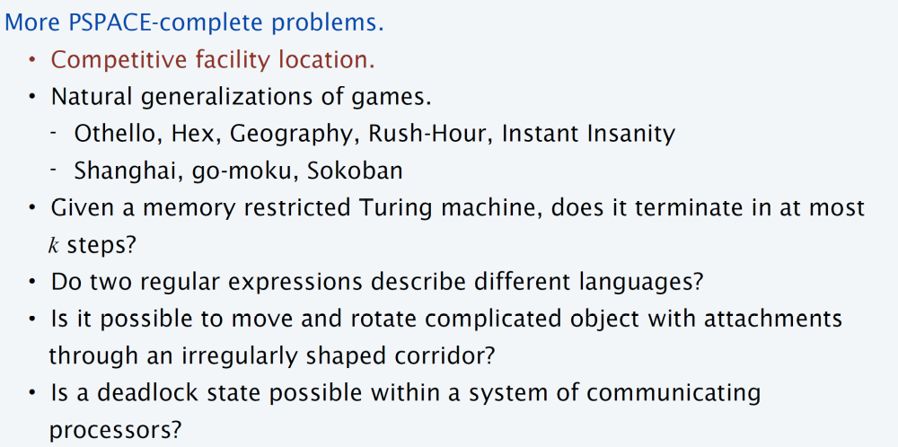

Slide 26
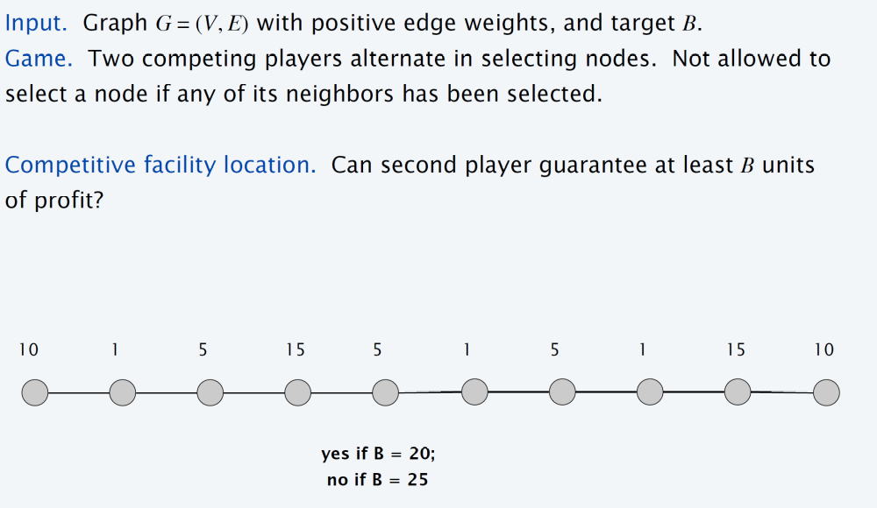
Competitive facility location

Slide 27
Winning Strategies for games:
φ =∃x₁ ∀x₂ ∃x₃…Qx_{k}[Ψ]
Q represents either a ∀ or an ∃ quantifier.
Two players: player A; player E.
Take turns selecting the values of x₁,…, x_{k.}
Player A selects values for the variables that are bound to ∀.
Player E selects values for the variables that are bound to ∃.
Player E wins, if Ψ is TRUE.
Player A wins, if Ψ is FALSE.

Slide 28
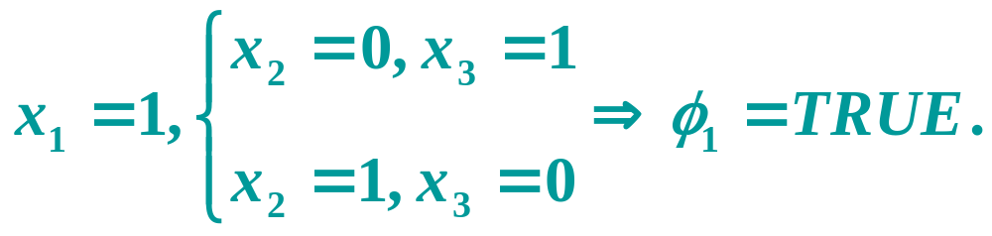
Eg.
Let φ₁ =∃x₁ ∀x₂ ∃x₃[(x₁∨ x₂) ∧ (x₂ ∨ x₃) ∧ (x₂∨ x₃)]
Player E has a winning strategy.
Let φ₂ =∃x₁ ∀x₂ ∃x₃[(x₁∨ x₂) ∧ (x₂ ∨ x₃) ∧ (x₂∨ x₃)]
Player A has a winning strategy.

Slide 29
FORMULA-GAME={<φ> | player E has a winning strategy in the formula game associated with φ}.
Thm: FORMULA-GAME is PSPACE-complete.
pf:
φ∈TQBF exactly when φ∈FORMULA-GAME.

Slide 30
Formulating Connectivity
The following formula, over variables u,v∈V and path’s length d, is TRUE iff G has a path from u to v of length ≤d
φ(u,v,1) ≡ f_{M,x}(u, v) ∨ u=v
φ(u,v,d) ≡ ∃w∀x∀y[((x=u∧y=w)∨(x=w∧y=v))→φ(x,y,d/2)]
w is reachable from u in ⎡d/2⎤ steps. v is reachable from w in ⎡d/2⎤ steps.
simulates AND of φ(u,w,d/2) and φ(w,v,d/2)

Slide 31
Summary
◉
We introduced a new way to classify problems: according to the space needed for their computation.
We defined several complexity classes: L, NL, PSPACE.

Slide 32
Summary
◉
Our main results were:
  Connectivity is NL-Complete
  TQBF is PSPACE-Complete
  Savitch’s theorem (NL⊆SPACE(log²))
  The padding argument (extending results for space complexity)
  Immerman’s theorem (NL=coNL)
By reducing decidability to reachability

Slide 33
